Slide 1
Ollie’s Genotyping Results
30.01.2026

Slide 2
PCO5FW/PCO5RV – PCO5
Brown

Slide 3
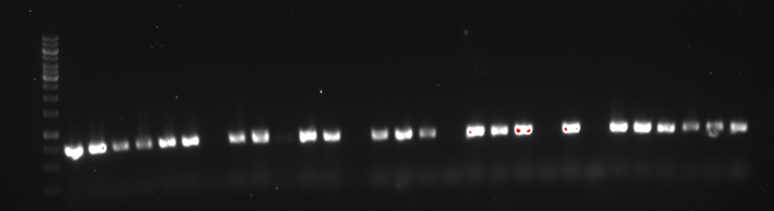
Ladder | Col-0 | C 63 | Gc-4-1 | Gc-3-1 | Gc-1-8 | Gc-1-9 | Gc-7-1 | Gc-8-1 | Gc-8-2 | Gc-1-12 | Gc-1-13 | Gc-1-15 | Gc-5-1 | Gc-3-2 | Gc-1-16 | Gc-5-2 | Pp-7-1 | Pp-7-2 | Pp-7-3 | Pp-7-4 | Pp-7-5 | Pp-7-6 | Pp-7-7 | Pp-7-8 | Pp-7-9 | Pp-7-10 | Pp-7-11 | Pp-7-12 | Pp-7-13
10000
8000
6000
5000
4000
3500
3000
2500
2000
1500
1000
750
500
250

Slide 4
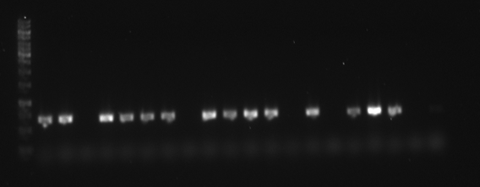
Ladder | Pp-7-14 | Pp-7-15 | Pp-7-17 | Pp-7-18 | Pp-7-20 | Pp-7-22 | Pp-5-1 | Pp-7-28 | Pp-9-1 | Pp-7-25 | Pp-8-1 | Pp-1-1 | Pp-7-27 | Pp-2-6 | Pp-7-30 | Pp-7-23 | Pp-7-24 | Pp-8-2 | Pp-7-31 | Pp-7-29
10000
8000
6000
5000
4000
3500
3000
2500
2000
1500
1000
750
500
250

Slide 5
PCO5FW/PCO5RV – PCO5
Pink

Slide 6
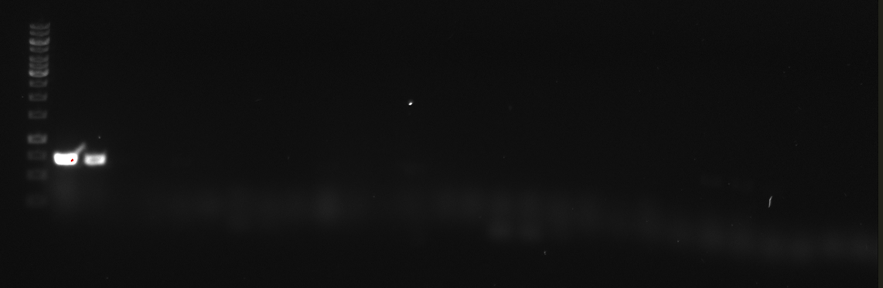
Ladder | Col-0 | 63 | Pp-10-1 | Pp-10-2 | Pp-10-3 | Pp-10-4 | Pp-10-5 | Pp-10-6 | Pp-10-7 | Pp-10-8 | Pp-10-9 | Pp-10-10 | Pp-10-11 | Pp-10-12 | Pp-10-13 | Pp-10-14 | Pp-10-15 | Pp-10-16 | Pp-10-17 | Pp-10-18 | Pp-10-19 | Pp-10-20 | Pp-10-21 | Pp-10-22 | Pp-10-23 | Pp-10-24 | Pp-10-25 | Pp-10-26 | Pp-10-27
10000
8000
6000
5000
4000
3500
3000
2500
2000
1500
1000
750
500
250

Slide 7
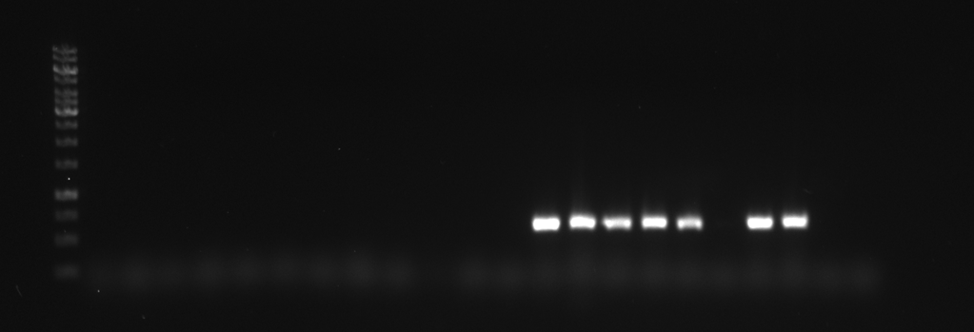
Ladder | Pp-10-28 | Pp-10-29 | Pp-10-30 | Pp-10-31 | Pp-10-32 | Pp-10-33 | Pp-10-34 | Pp-10-35 | Pp-10-36 | Pp-10-37 | Pp-10-38 | Pp-10-39 | Pp-2-2 | Gc-1-2 | Gc-1-4 | Gc-1-5 | Gc-1-6 | Gc-1-7 | Gc-1-10 | Gc-1-14
10000
8000
6000
5000
4000
3500
3000
2500
2000
1500
1000
750
500
250

Slide 8
LBb1/PCO5RV - tDNA
Purple

Slide 9
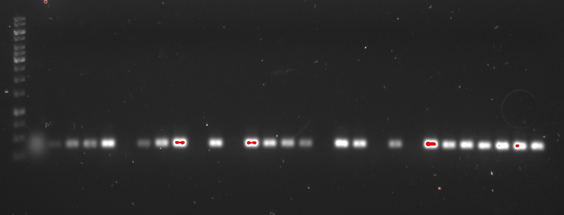
Ladder | C3 | 4pco ko | Gc-4-1 | Gc-3-1 | Gc-1-8 | Gc-1-9 | Gc-7-1 | Gc-8-1 | Gc-8-2 | Gc-1-12 | Gc-1-13 | Gc-1-15 | Gc-5-1 | Gc-3-2 | Gc-1-16 | Gc-5-2 | Gc-1-2 | Gc-1-4 | Gc-1-5 | Gc-1-6 | Gc-1-7 | Gc-1-10 | Gc-1-14 | Pp-7-1 | Pp-7-2 | Pp-7-3 | Pp-7-4 | Pp-7-5 | Pp-7-6
10000
8000
6000
5000
4000
3500
3000
2500
2000
1500
1000
750
500
250

Slide 10
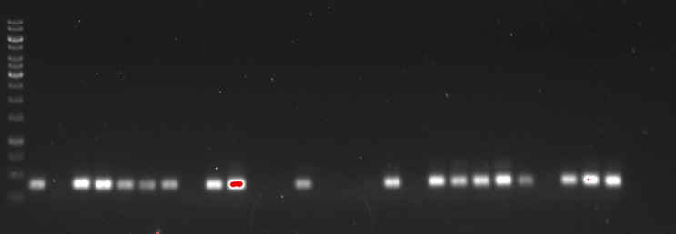
Ladder | Pp-7-7 | Pp-7-8 | Pp-7-9 | Pp-7-10 | Pp-7-11 | Pp-7-12 | Pp-7-13 | Pp-7-14 | Pp-7-15 | Pp-7-17 | Pp-7-18 | Pp-7-20 | Pp-7-22 | Pp-5-1 | Pp-7-28 | Pp-9-1 | Pp-7-25 | Pp-8-1 | Pp-1-1 | Pp-7-27 | Pp-2-6 | Pp7-30 | Pp-7-23 | Pp-7-24 | Pp-8-2 | Pp-7-31 | Pp-7-29
10000
8000
6000
5000
4000
3500
3000
2500
2000
1500
1000
750
500
250

Slide 11
LBb1/PCO5RV – tDNA
Cyan

Slide 12
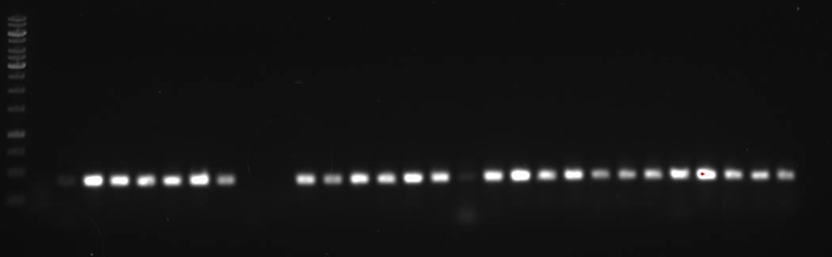
Ladder | C3 | 4pco KO | Pp-10-1 | Pp-10-2 | Pp-10-3 | Pp-10-4 | Pp-10-5 | Pp-10-6 | Pp-10-7 | Pp-10-8 | Pp-10-9 | Pp-10-10 | Pp-10-11 | Pp-10-12 | Pp-10-13 | Pp-10-14 | Pp-10-15 | Pp-10-16 | Pp-10-17 | Pp-10-18 | Pp-10-19 | Pp-10-20 | Pp-10-21 | Pp-10-22 | Pp-10-23 | Pp-10-24 | Pp-10-25 | Pp-10-26 | Pp-10-27
10000
8000
6000
5000
4000
3500
3000
2500
2000
1500
1000
750
500
250

Slide 13
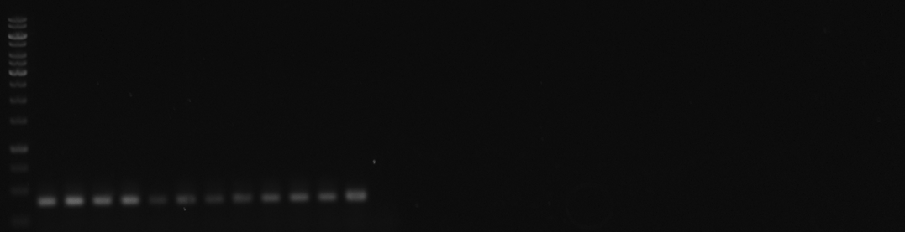
Ladder | Pp-10-28 | Pp-10-29 | Pp-10-30 | Pp-10-31 | Pp-10-32 | Pp-10-33 | Pp-10-34 | Pp-10-35 | Pp-10-36 | Pp-10-37 | Pp-10-38 | Pp-10-39 | Pp-2-2
10000
8000
6000
5000
4000
3500
3000
2500
2000
1500
1000
750
500
250

Slide 14
PpFW/PpRV – PpPCO
Dark Blue/Green

Slide 15
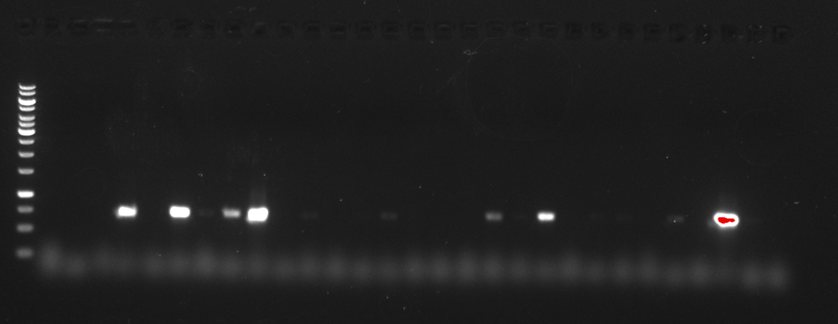
Ladder | C3 | 4pco KO | Pp-10-1 | Pp-10-2 | Pp-10-3 | Pp-10-4 | Pp-10-5 | Pp-10-6 | Pp-10-7 | Pp-10-8 | Pp-10-9 | Pp-10-10 | Pp-10-11 | Pp-10-12 | Pp-10-13 | Pp-10-14 | Pp-10-15 | Pp-10-16 | Pp-10-17 | Pp-10-18 | Pp-10-19 | Pp-10-20 | Pp-10-21 | Pp-10-22 | Pp-10-23 | Pp-10-24 | Pp-10-25 | Pp-10-26 | Pp-10-27
10000
8000
6000
5000
4000
3500
3000
2500
2000
1500
1000
750
500
250

Slide 16
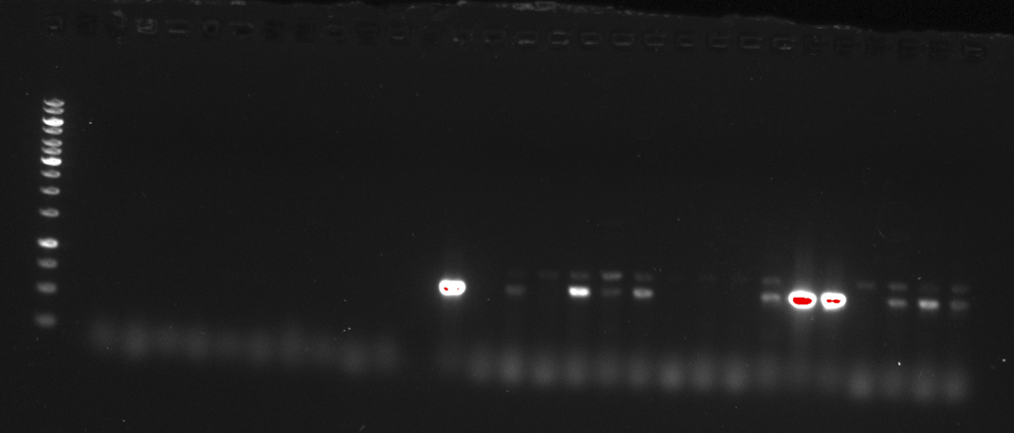
Ladder | Pp-10-28 | Pp-10-29 | Pp-10-30 | Pp-10-31 | Pp-10-32 | Pp-10-33 | Pp-10-34 | Pp-10-35 | Pp-10-36 | Pp-10-37 | Pp-10-38 | Pp-10-39 | Pp-2-2 | Pp-7-1 | Pp-7-2 | Pp-7-3 | Pp-7-4 | Pp-7-5 | Pp-7-6 | Pp-7-7 | Pp-7-8 | Pp-7-9 | Pp-7-10 | Pp-7-11 | Pp-7-12 | Pp-7-13 | Pp-7-14 | Pp-7-15 | Pp-7-17
10000
8000
6000
5000
4000
3500
3000
2500
2000
1500
1000
750
500
250

Slide 17
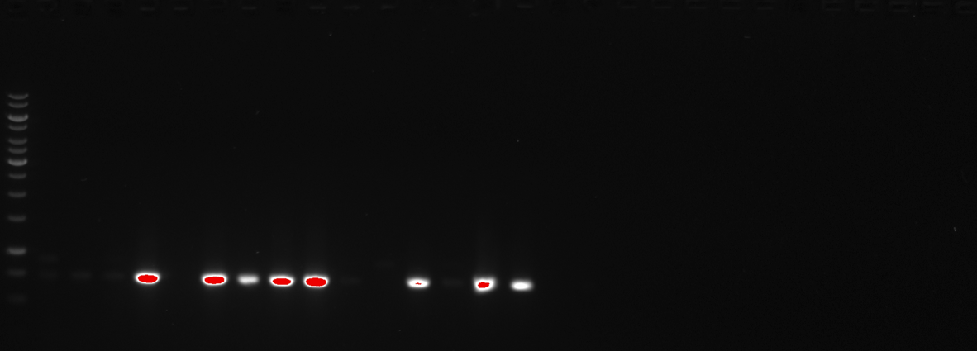
Ladder | Pp-7-18 | Pp-7-20 | Pp-7-22 | Pp-5-1 | Pp-7-28 | Pp-9-1 | Pp-7-25 | Pp-8-1 | Pp-1-1 | Pp-7-27 | Pp-2-6 | Pp-7-30 | Pp-7-23 | Pp-7-24 | Pp-8-2 | Pp-7-31 | Pp-7-29
10000
8000
6000
5000
4000
3500
3000
2500
2000
1500
1000
750

Slide 18
GcFW/GcRV – GcPCO
Light Blue

Slide 19
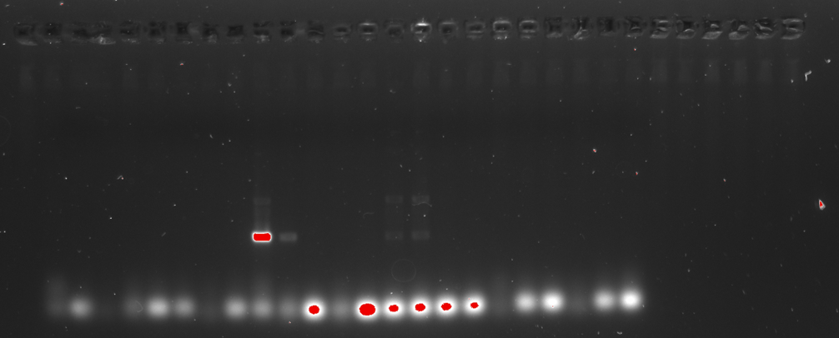
Ladder | C3 | 4pco KO | Gc-4-1 | Gc-3-1 | Gc-1-8 | Gc-1-9 | Gc-7-1 | Gc-8-1 | Gc-8-2 | Gc-1-12 | Gc-1-13 | Gc-1-15 | Gc-5-1 | Gc-3-2 | Gc-1-16 | Gc-5-2 | Gc-1-2 | Gc-1-4 | Gc-1-5 | Gc-1-6 | Gc-1-7 | Gc-1-10 | Gc-1-14

Slide 20
AttB1/AttB2 – GcPCO retest
Light Blue

Slide 21
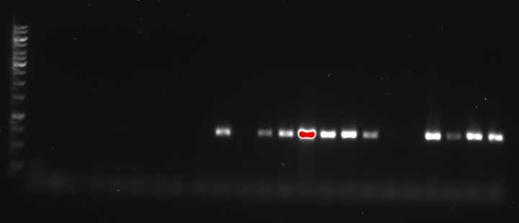
Ladder | C3 | 4pco KO | Gc-1-2 | Gc-1-4 | Gc-1-5 | Gc-1-6 | Gc-1-7 | Gc-1-10 | Gc-1-14 | Gc-1-13 | Gc-1-15 | Gc-7-1 | Gc-8-1 | Gc-8-2 | Gc-1-12 | Gc-4-1 | Gc-3-1 | Gc-1-8 | Gc-1-9 | Gc-5-1 | Gc-5-2 | Gc-3-2 | Gc-1-16
10000
8000
6000
5000
4000
3500
3000
2500
2000
1500
1000
750
500
250

Slide 22
GcFW/GcRV – GcPCO retest
Pink

Slide 23
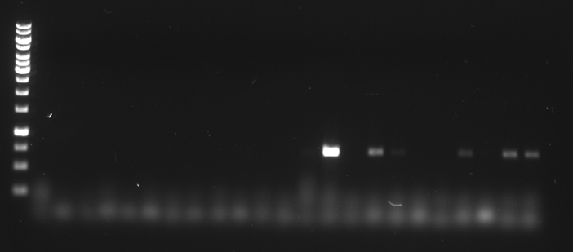
Ladder | C3 | 4pco KO | Gc-1-2 | Gc-1-4 | Gc-1-5 | Gc-1-6 | Gc-1-7 | Gc-1-10 | Gc-1-14 | Gc-1-13 | Gc-1-15 | Gc-7-1 | Gc-8-1 | Gc-8-2 | Gc-1-12 | Gc-4-1 | Gc-3-1 | Gc-1-8 | Gc-1-9 | Gc-5-1 | Gc-5-2 | Gc-3-2 | Gc-1-16
10000
8000
6000
5000
4000
3500
3000
2500
2000
1500
1000
750
500
250

